Slide 1

Causal Inference and Counterfactual Reasoning
Tutorial @ KDD 2018
http://causalinference.gitlab.io/kdd-tutorial/
Emre Kıcıman and Amit Sharma
emrek@microsoft.com, amshar@microsoft.com
Causal Inference and Counterfactual Reasoning at Microsoft Research

Slide 2
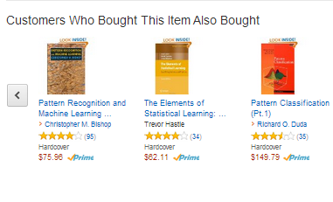
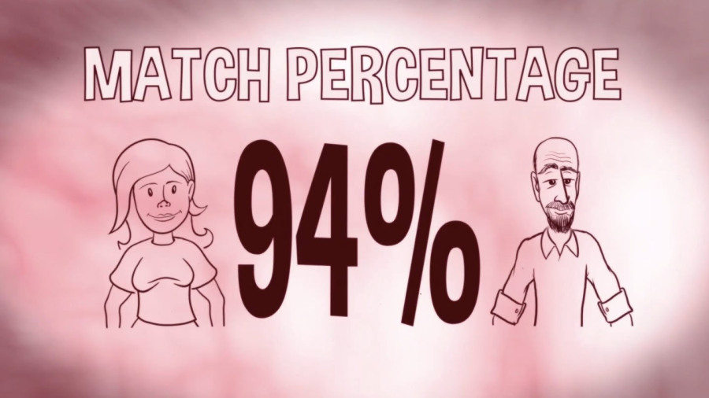

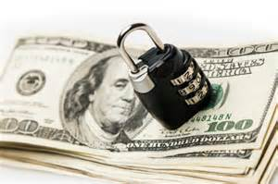
Predictive systems are impacting our lives

Slide 3
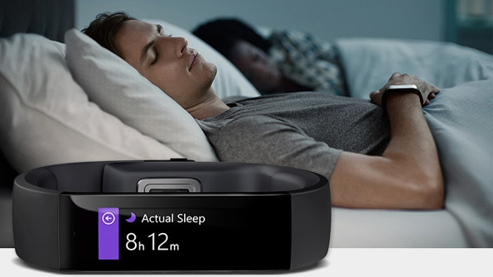
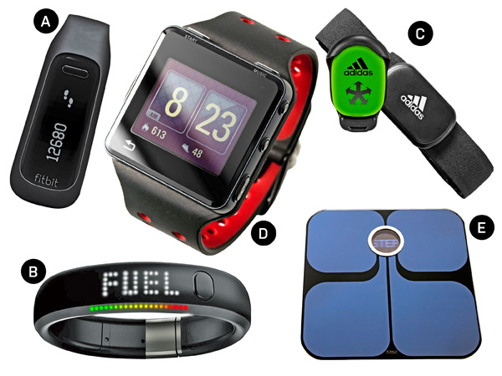

Slide 4

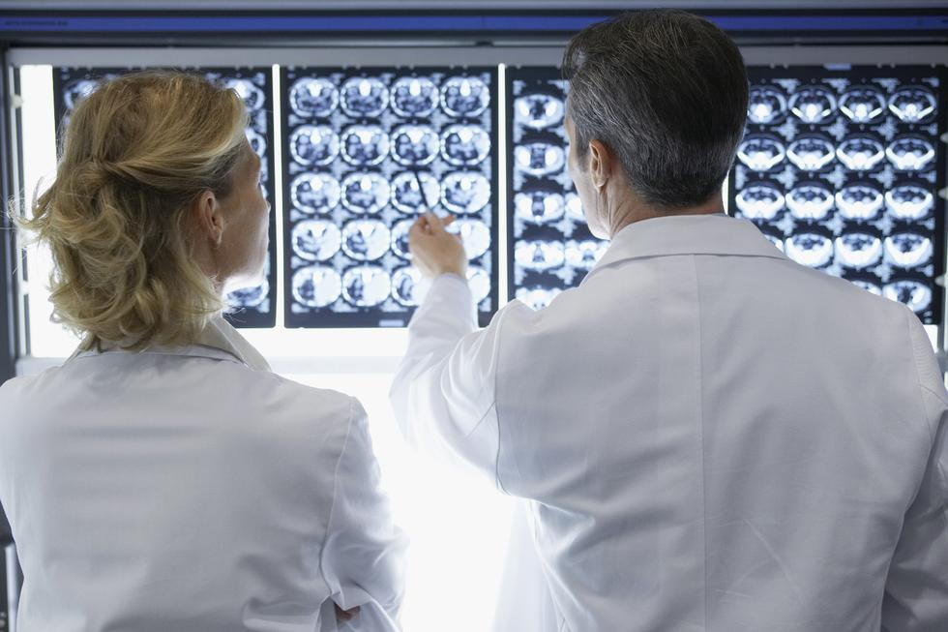




Slide 5
Why should we care about causality? We have increasing amounts of data and highly accurate predictions. How is causal inference useful?

Slide 6
1) Do prediction models guide decision-making?

Slide 7
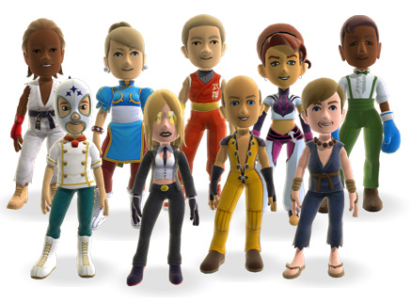

From data to prediction
Can we predict a user's future activity based on exposure to their social feed?
Use the social feed to predict a user's future activity.
Future Activity -> f( items in social feed) + $ε$
Future Activity -> f( items in social feed) + 𝜖
Highly predictive model.
Does it mean that feeds are influencing us significantly?

Slide 8
From prediction to decision-making
Predictability due to
feed influence
Predictability due to
homophily
Would changing what people see in the feed affect what a user likes?
Maybe, maybe not (!)
Homophily
Items in Social Feed
Items liked by a user
Items in Social Feed
Items liked by a user
Friends’ activity can predict a person’s activity with high accuracy.
But that tells us nothing about the effect of the social feed.

Slide 9
2) Will the predictions be robust tomorrow, or in new contexts?

Slide 10
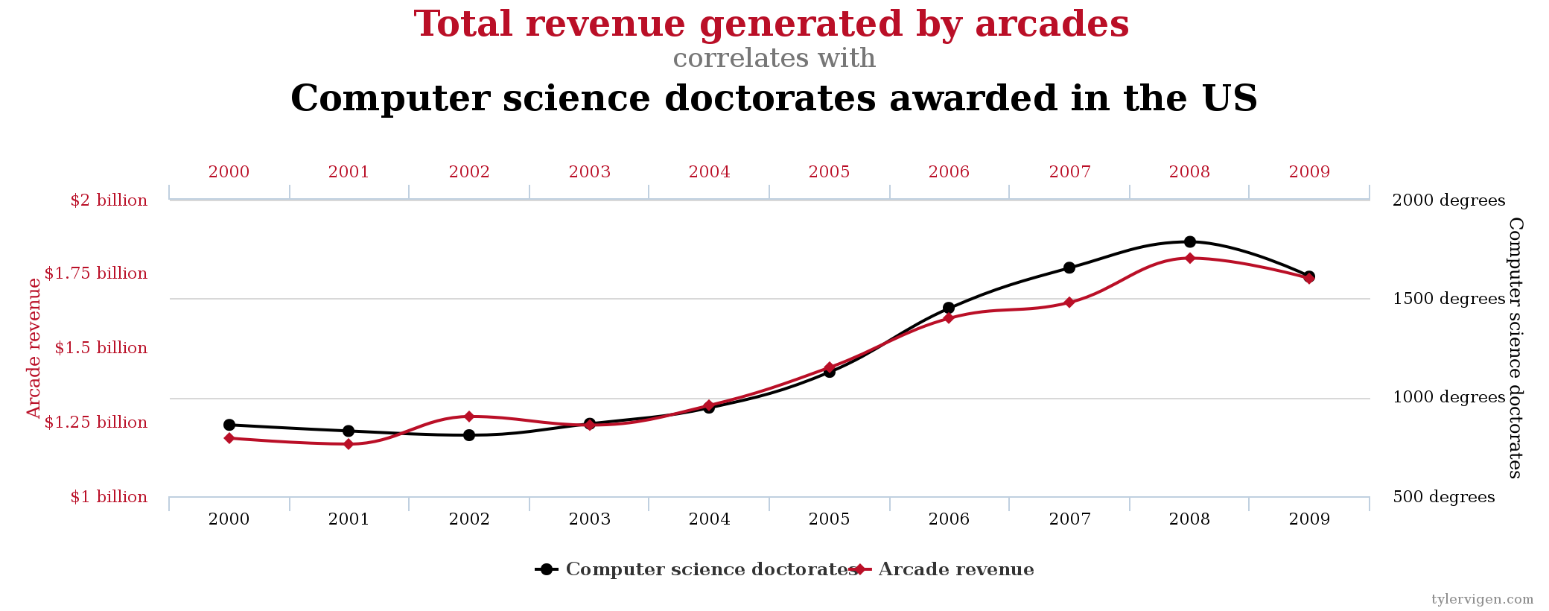
http://www.tylervigen.com/spurious-correlations

Slide 11
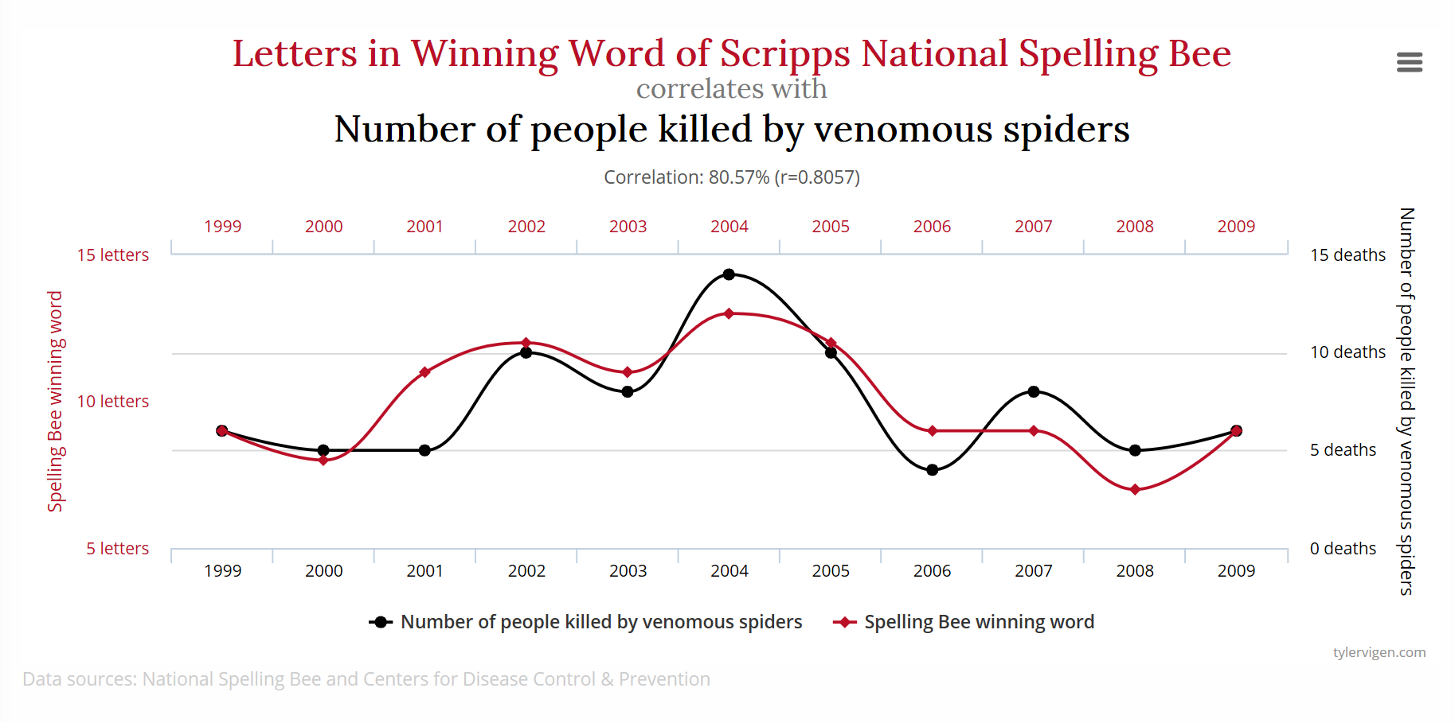

Slide 12
3) What if the prediction accuracy is really high?

Slide 13


Interventions change the environment
Train/test from same distribution in supervised learning
No such guarantee in real life!
Problematic: Acting on a prediction changes distribution!
Incl. critical domains: healthcare or adversarial scenarios.
Connections to covariate shift, domain adaptation [Mansour et al. 2009, Ben-David 2007].

Slide 14
Recap: Prediction is insufficient for choosing interventions
How often do they lead us to the right decision?
Active interventions change correlations
Correlations can change
What if the prediction accuracy is really high? Does that help?
Causal mechanisms more robust
Unclear, predictive algorithms provide no insight on effects of decisions
Will the predictions be robust tomorrow, or in new contexts?

Slide 15
PART I. Introduction to Counterfactual Reasoning PART II. Methods for Causal Inference PART III. Large-scale and Network Data PART IV. Broader Landscape

Slide 16
PART I. Introduction to Counterfactual Reasoning
What is causality?
Potential Outcomes Framework
Unobserved Confounds / Simpson’s Paradox
Structural Causal Model Framework

Slide 17
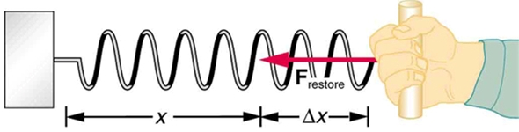

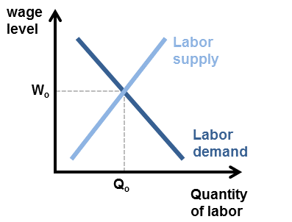
Cause and Effect
Questions of cause and effect common in biomedical and social sciences
Such questions form the basis of almost all scientific inquiry
Medicine: drug trials, effect of a drug
Social sciences: effect of a certain policy
Genetics: effect of genes on disease
So what is causality?
What does it mean to cause something?

Slide 18
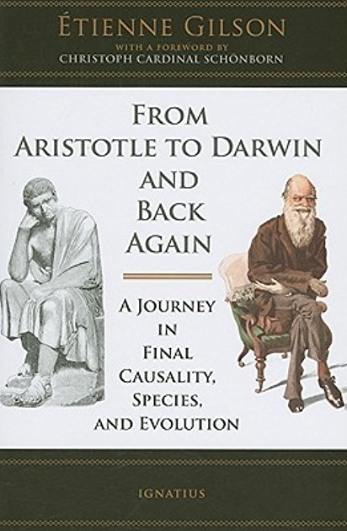
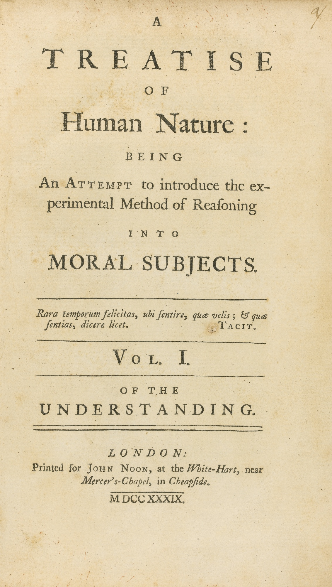
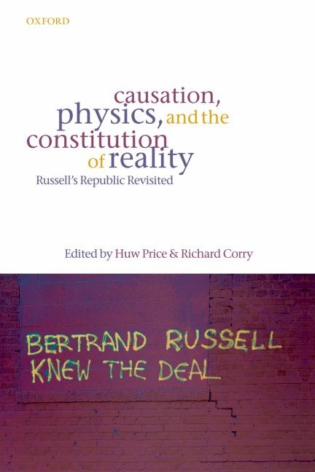

A big scholarly debate, from Aristotle to Russell

Slide 19


Slide 20
What is causality?
A fundamental question
Surprisingly, until very recently---maybe the last 30+ years---we have not had a mathematical language of causation. We have not had an arithmetic for representing causal relationships.
“More has been learned about causal inference in the last few decades than the sum total of everything that had been learned about it in all prior recorded history”
--Gary King, Harvard University

Slide 21
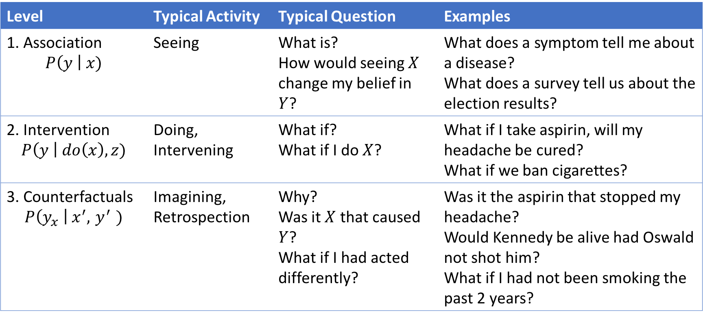
The Three Layer Causal Hierarchy Pearl, Theoretical Impediments to Machine Learning with Seven Sparks from the Causal Revolution, arXiv:1801.04016v1. 11 Jan 2018
Level | Typical Activity | Typical Question | Examples
1. Association $$P\left(y \right| x)$$ | Seeing | What is? How would seeing $X$ change my belief in $Y$? | What does a symptom tell me about a disease? What does a survey tell us about the election results?
2. Intervention $$P\left(y \right| do\left(x\right), z)$$ | Doing, Intervening | What if? What if I do $X$? | What if I take aspirin, will my headache be cured? What if we ban cigarettes?
3. Counterfactuals $$P\left(y_{x} \right| x^{′}, { y}^{′} )$$ | Imagining, Retrospection | Why? Was it $X$ that caused $Y$? What if I had acted differently? | Was it the aspirin that stopped my headache? Would Kennedy be alive had Oswald not shot him? What if I had not been smoking the past 2 years?

Slide 22
A practical definition
Definition: T causes Y iff
changing T leads to a change in Y,
keeping everything else constant.
The causal effect is the magnitude by which Y is changed by a unit change in T.
Called the “interventionist” interpretation of causality.
*Interventionist definition [http://plato.stanford.edu/entries/causation-mani/]

Slide 23

Keeping everything else constant: Imagine a counterfactual world
“What-if” questions
Reason about a world that does not exist.
- What if a system intervention was not done?
What if an algorithm was changed?
What if I gave a drug to a patient?

Slide 24
PART I. Introduction to Counterfactual Reasoning
What is causality?
Potential Outcomes Framework
Unobserved Confounds / Simpson’s Paradox
Structural Causal Model Framework

Slide 25


Potential Outcomes framework
Alice
Treatment

Slide 26
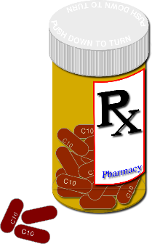
Potential Outcomes framework
Alice

Slide 27
Potential Outcomes framework
X X
Alice

Slide 28
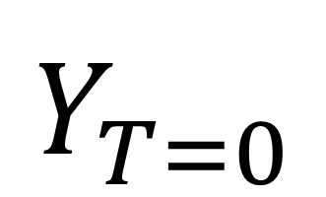
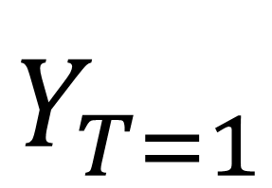
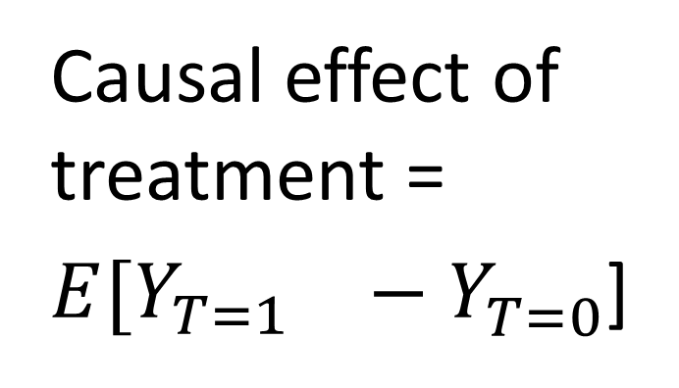
Potential Outcomes framework: Introduce a counterfactual quantity
Causal effect of treatment = ${E[Y_{T=1}}^{}−Y_{T=0}^{}$]
X X
$$Y_{T=1}^{}$$
$$Y_{T=0}^{}$$

Slide 29
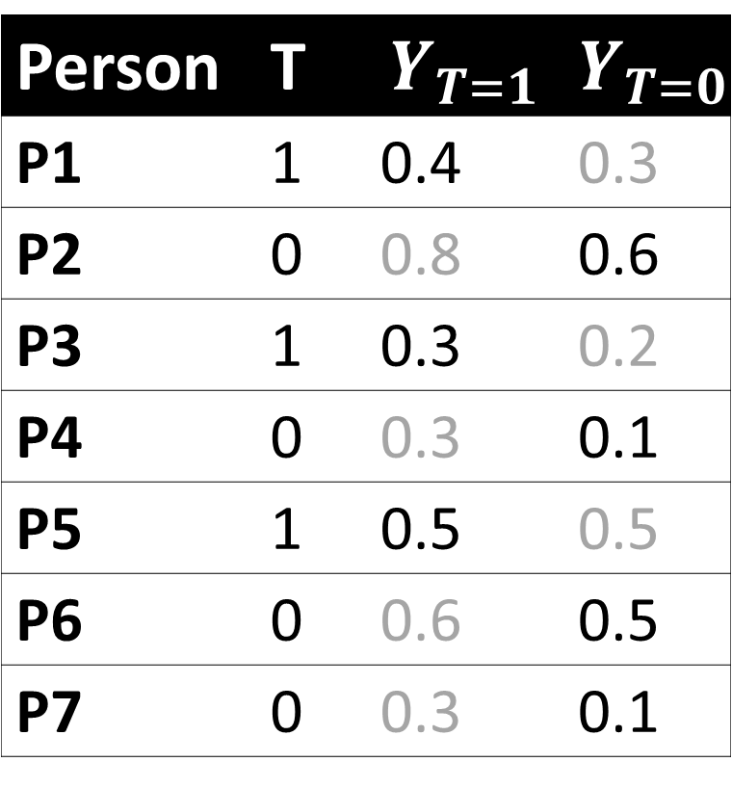
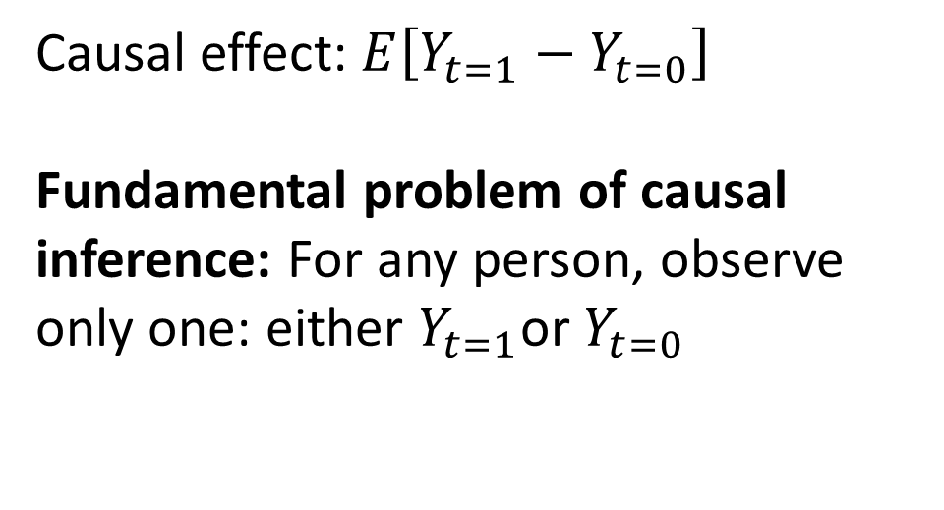
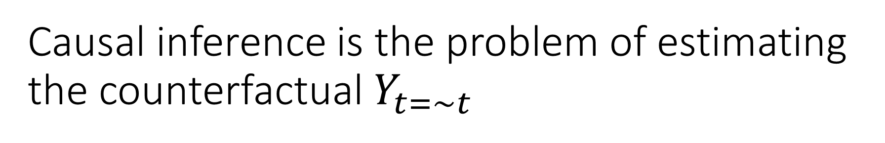
Causal inference is the problem of estimating the counterfactual $Y_{t=\sim t}$
Person | T | $$Y_{T=1}$$ | $$Y_{T=0}$$
P1 | 1 | 0.4 | 0.3
P2 | 0 | 0.8 | 0.6
P3 | 1 | 0.3 | 0.2
P4 | 0 | 0.3 | 0.1
P5 | 1 | 0.5 | 0.5
P6 | 0 | 0.6 | 0.5
P7 | 0 | 0.3 | 0.1
Causal effect: $E\left[Y_{t=1}−Y_{t=0}\right]$
Fundamental problem of causal inference: For any person, observe only one: either $Y_{t=1}$or $Y_{t=0}$

Slide 30




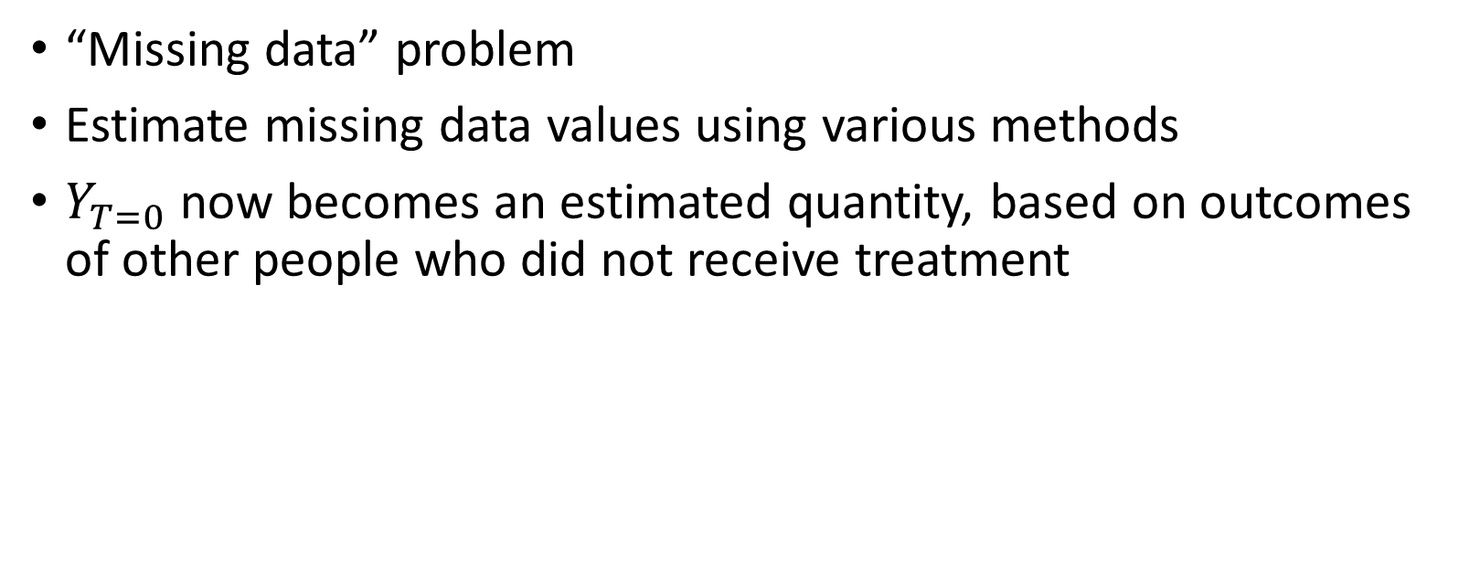
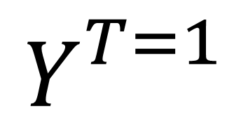
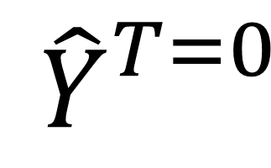
Fundamental problem: counterfactual outcome is not observed
“Missing data” problem
Estimate missing data values using various methods
$Y_{T=0}$ now becomes an estimated quantity, based on outcomes of other people who did not receive treatment
X X
$${ \hat{Y}}_{}^{T=0}$$
$$Y_{}^{T=1}$$

Slide 31
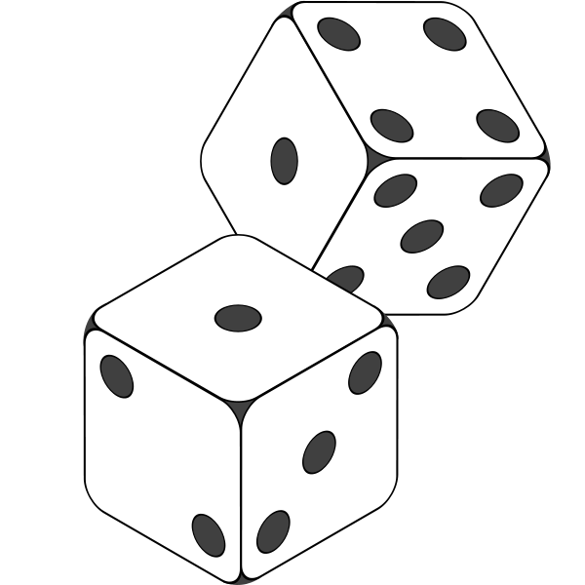





Randomized Experiments are the “gold standard”
One way to estimate counterfactual

Slide 32
Cost: Possibly risky, unethical
Unethical to deny useful treatment or administer risky treatment.
Infeasible or costly in other situations.
What can we do when an experiment is not possible?
Coming soon in Section 2

Slide 33
Recap: Potential Outcomes Framework
Potential outcomes reasons about causal effects by comparing outcome of treatment to outcome of no-treatment
For any individual, we cannot observe both treatment and no-treatment.
Randomized experiments are one solution
We’ll discuss others in tutorial Section 2

Slide 34
PART I. Introduction to Counterfactual Reasoning
What is causality?
Potential Outcomes Framework
Structural Causal Model Framework
Unobserved Confounds / Simpson’s Paradox

Slide 35

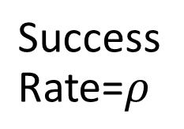
Example: Auditing the effect of an algorithm
System changes algorithm from A to B at some point.
Is the new algorithm B better?
Say a feature that provides information or discount for a financial product.
Success Rate=$ρ$
?
Algorithm A
Algorithm B

Slide 36
New algorithm increases overall success rate
Two algorithms, A (old) and B (new) running on the system.
From system logs, collect data for 1000 sessions for each. Measure Success Rate (SR).
Old Algorithm (A) | New Algorithm (B)
50/1000 (5%) | 54/1000 (5.4%)
New algorithm is better?

Slide 37
Unobserved Confounds
What if there are unobserved features of audience that matter?
Old Algorithm (A) | New Algorithm (B)
10/400 (2.5%) | 4/200 (2%)
Low-income Users
Old Algorithm (A) | New Algorithm (B)
40/600 (6.6%) | 50/800 (6.2%)
High-income Users

Slide 38
The Simpson’s paradox: New algorithm is better overall, but worse for each subgroup
 | Old algorithm (A) | New Algorithm (B)
CTR for Low-Activity users | 10/400 (2.5%) | 4/200 (2%)
CTR for High-Activity users | 40/600 (6.6%) | 50/800 (6.2%)
Total CTR | 50/1000 (5%) | 54/1000 (5.4%)
So, which is better?
Simpson (1951)

Slide 39
From metrics to decision-making
Higher success rate due to
new algorithm
Higher success rate due to
selection effects
Did the change to new Algorithm increase success rate for the system?
Answer (as usual):
Maybe, maybe not (!)
Income
Financial product offer
Accepted
Financial product offer
Accepted
E.g., Algorithm B is shown at a different time than A.
There could be other hidden causal variations.
Not just theory. Differences in interpretations can attract lawsuits (UC Berkeley admissions, 1973)

Slide 40
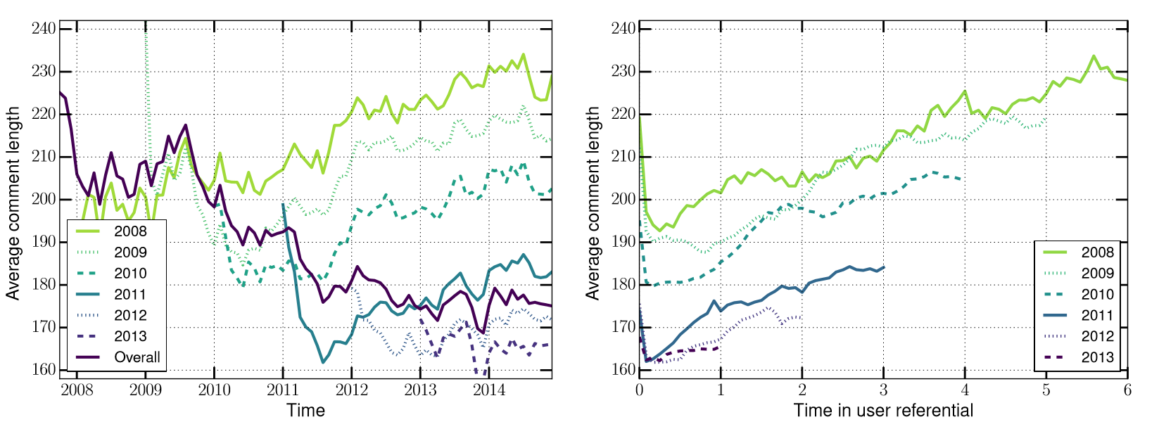
Example: Simpson’s paradox in Reddit
Average comment length decreases over time.
But for each yearly cohort of users, comment length increases over time.
Barbosa-Cosley-Sharma-Cesar (2016)

Slide 41
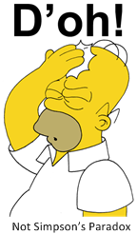
Making sense of such data can be too complex.

Slide 42
Recap: Unobserved Confounds
Unobserved confounds are a threat to causal reasoning

Slide 43
PART I. Introduction to Counterfactual Reasoning
What is causality?
Potential Outcomes Framework
Structural Causal Model Framework
Unobserved Confounds / Simpson’s Paradox

Slide 44
Real world is complicated
People may have inter-related characteristics
How are these characteristics associated with each other?
Other factors can influence the observed outcome
How do they affect treatment and outcome?
Which ones to include?
How to identify the causal effect in such cases?
When is it possible to find a causal effect?
We can use graphical model framework to answer this

Slide 45
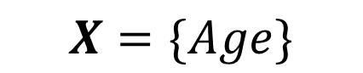
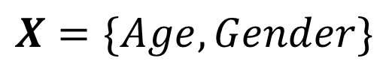

Which variables to condition on?
Age
Age
Gender
Age
Stress
T
Y
T
Y
T
Y
$$X=\{Age\}$$
$$X=\{Age, Gender\}$$
$$X=\{Age\}$$

Slide 46


Age
Stress
Age
Exercise
Occupation
Muscle Strength
T
Y
T
Y
$$X=?$$
$$X=?$$

Slide 47
Another example: Repeated treatment (!)
BP1
Age
BP2
T1
Y
T2
Y
How to reason about causal effects in such cases?

Slide 48
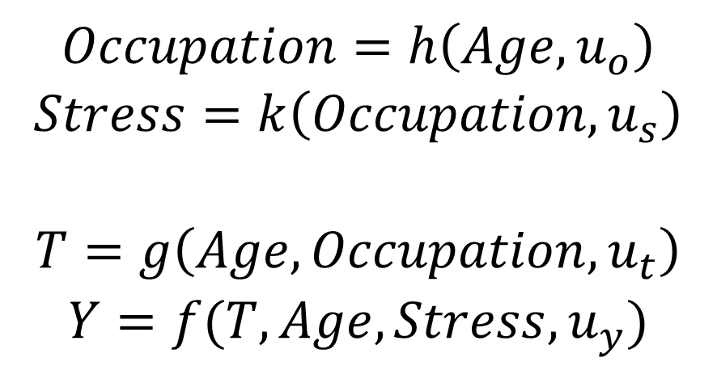
Structural Causal Model: A framework for expressing complex causal relationships
Age
Stress
$$Occupation=h\left(Age, u_{o}\right)$$
$$Stress=k\left(Occupation, u_{s}\right)$$
$$T=g\left(Age,Occupation, u_{t}\right)$$
$$Y=f(T, Age, Stress, u_{y})$$
Occupation
T
Y
Edges represent direct causes.
Directed paths represent indirect causes.

Slide 49
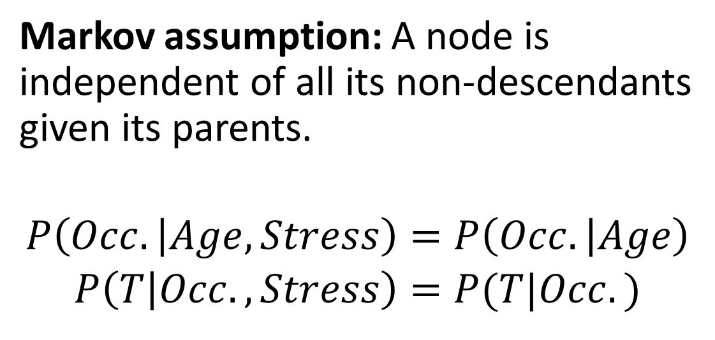
Structural Causal Model: A framework for expressing complex causal relationships
Age
Stress
Markov assumption: A node is independent of all its non-descendants given its parents.
$$P\left(Occ. | Age, Stress\right)=P\left(Occ. | Age\right)$$
$$P\left(T | Occ.,Stress\right)=P(T|Occ.)$$
Occupation
T
Y
$$P\left(G\right)=P\left(Age\right)P\left(Occ. | Age\right)P\left(Stress | Occ.\right)P\left(T | Age,Occ.\right)P(Y|T,Age, Stress)$$

Slide 50
Structural Causal Model: Causal effect is represented by the intervention distribution
Age
Stress
Counterfactual (Intervention) world:
All edges to Treatment T removed, keeping everything else the same.
Observed correlation = P(Y|T)
Causal Effect = P*(Y|T)
Occupation
T
Y
$$P^{∗}\left(Φ\right)=P\left(Age\right)P\left(Occ. | Age\right)P\left(Stress | Occ.\right)P^{∗}\left(T | Age,Occ.\right)P(Y|T,Age, Stress)$$

Slide 51
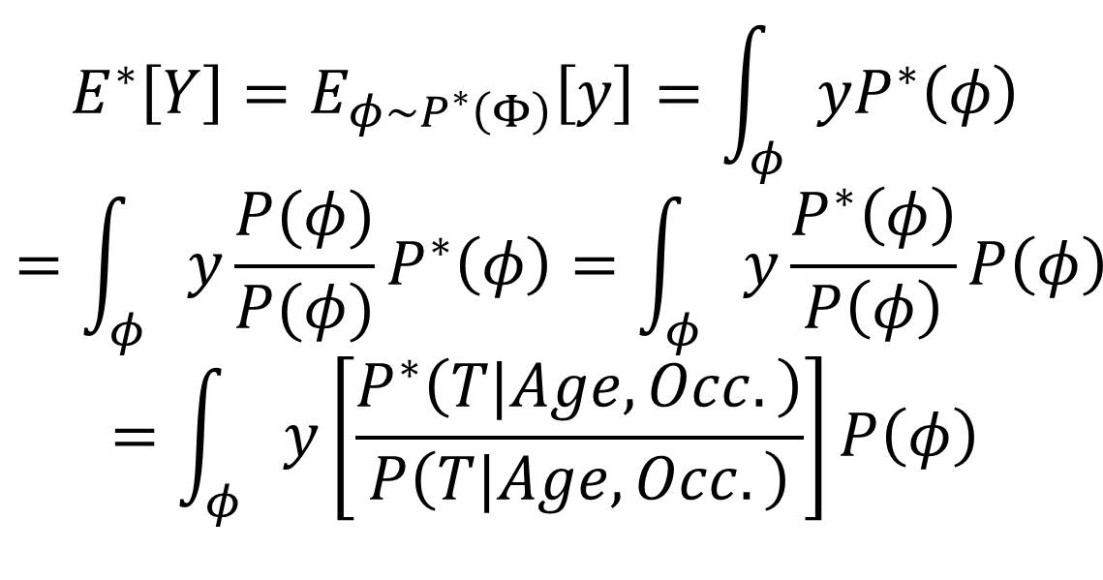
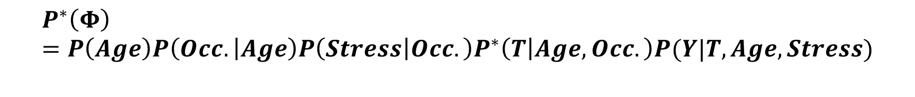
Structural Causal Model: Causal effect is represented by the intervention distribution
Age
Stress
$$E^{∗}\left[Y\right]=E_{φ\sim P^{∗}\left(Φ\right)}\left[y\right]=\int_{φ}{yP^{∗}\left(φ\right)}$$
$$=\int_{φ}{y{\frac{P(φ)}{P(φ)}P}^{∗}\left(φ\right)=\int_{φ}{y\frac{P^{∗}\left(φ\right)}{P\left(φ\right)}P\left(φ\right)}}$$
$$=\int_{φ}{y\left[\frac{P^{∗}\left(T|Age,Occ.\right)}{P\left(T|Age,Occ.\right)}\right]P\left(φ\right)}$$
Occupation
T
Y
$$P^{∗}\left(Φ\right)=P\left(Age\right)P\left(Occ. | Age\right)P\left(Stress | Occ.\right)P^{∗}\left(T | Age,Occ.\right)P(Y|T,Age, Stress)$$

Slide 52
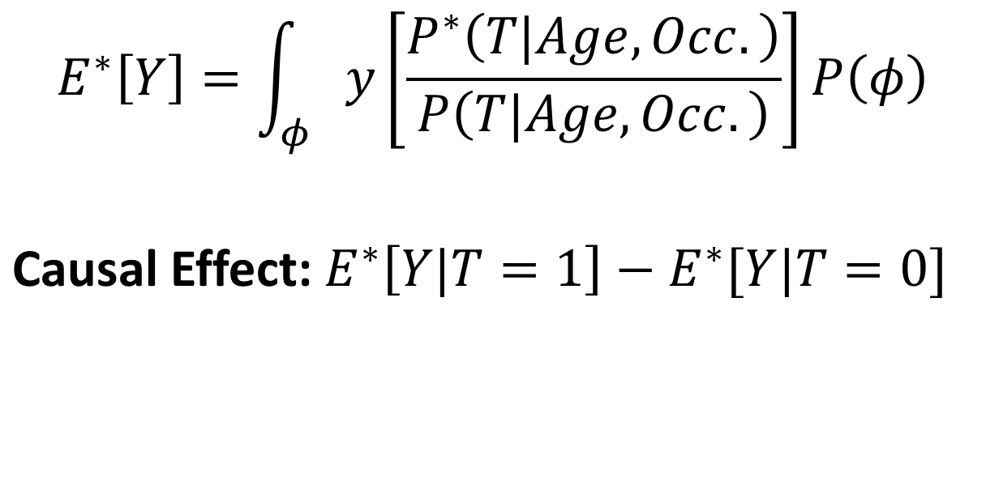
Structural Causal Model: Causal effect is represented by the intervention distribution
Age
Stress
$$E^{∗}\left[Y\right]=\int_{φ}{y\left[\frac{P^{∗}\left(T|Age,Occ.\right)}{P\left(T|Age,Occ.\right)}\right]P\left(φ\right)}$$
Causal Effect: $E^{∗}\left[Y|T=1\right]−E^{∗}[Y|T=0]$
Occupation
T
Y

Slide 53
Structural Causal Model makes assumptions explicit
Age
Stress
Age
Exercise
Occupation
Muscle Strength
T
Y
T
Y
The graph encodes all causal assumptions.

Slide 54
Important: Assumptions are the edges that are missing
Age
Stress
Assumption 1: Occupation does affect outcome Y.
Assumption 2: Age does not affect stress.
Assumption 3: Stress does not affect Occupation.
Assumption 4: Treatment does not affect stress.
..and so on.
Occupation
T
Y
Condition for validity: The graph reflects all relevant causal processes.

Slide 55
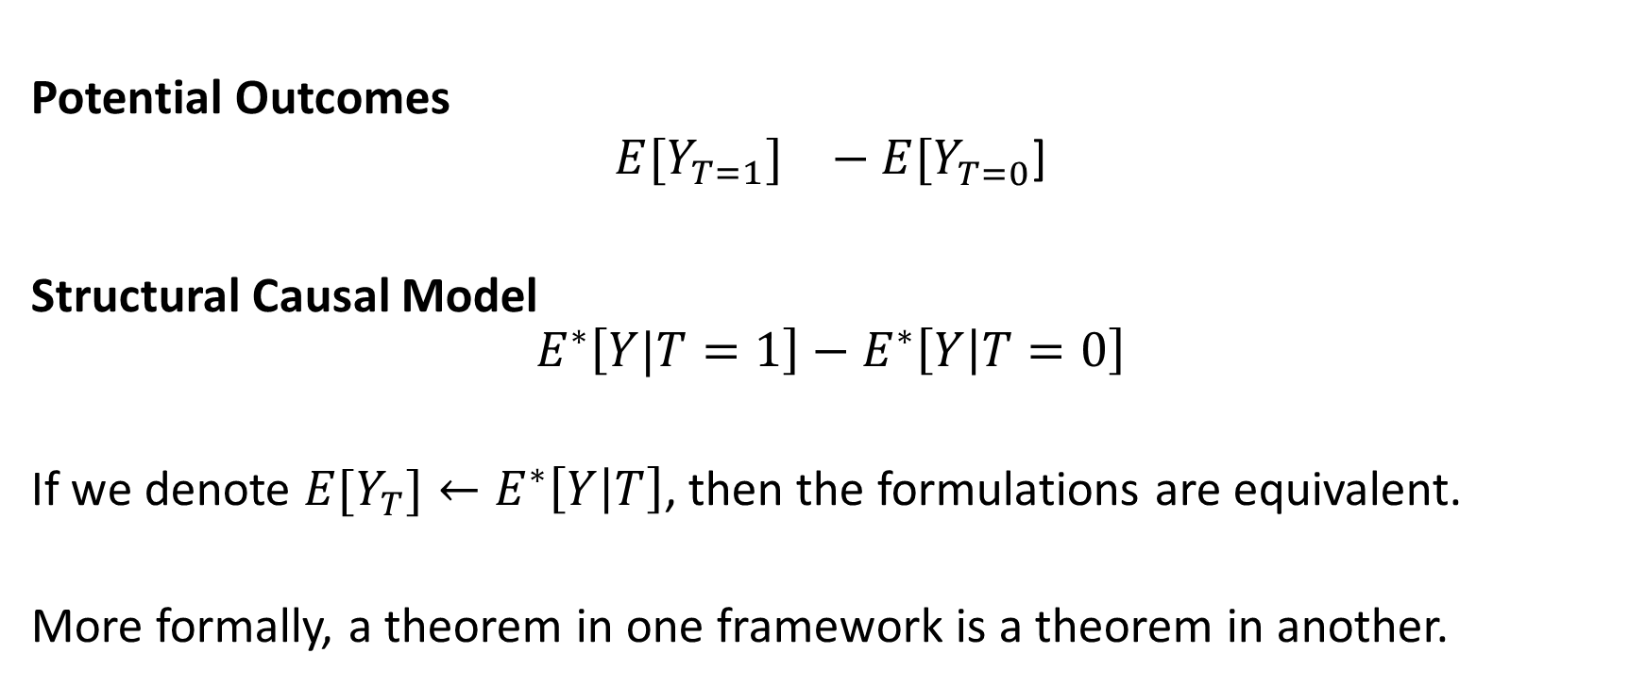
Important: SCM and Potential Outcome frameworks are equivalent
Potential Outcomes
$${E[Y_{T=1}]}^{}−E[Y_{T=0}^{}\text{]}$$
Structural Causal Model
$$E^{∗}\left[Y|T=1\right]−E^{∗}\left[Y | T=0\right]$$
If we denote ${E[Y}_{T}]←E^{∗}\left[Y | T\right]$, then the formulations are equivalent.
More formally, a theorem in one framework is a theorem in another.

Slide 56
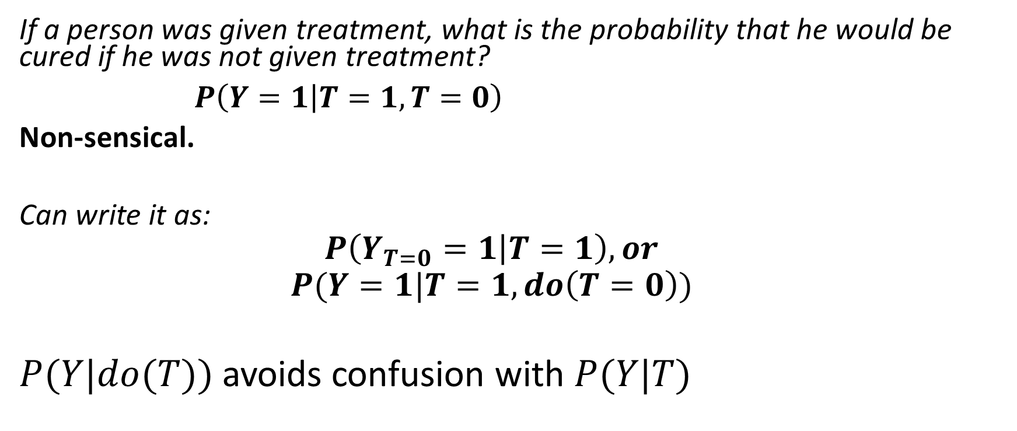
Key Benefit (1) of SCM: Provides a language for expressing counterfactuals
If a person was given treatment, what is the probability that he would be cured if he was not given treatment?
$P\left(Y=1 | T=1, T=0\right)$
Non-sensical.
Can write it as:
$$P\left(Y_{T=0}=1 | T=1\right), or$$
$$P(Y=1|T=1, do\left(T=0\right))$$
$P(Y|do(T))$ avoids confusion with $P(Y|T)$

Slide 57
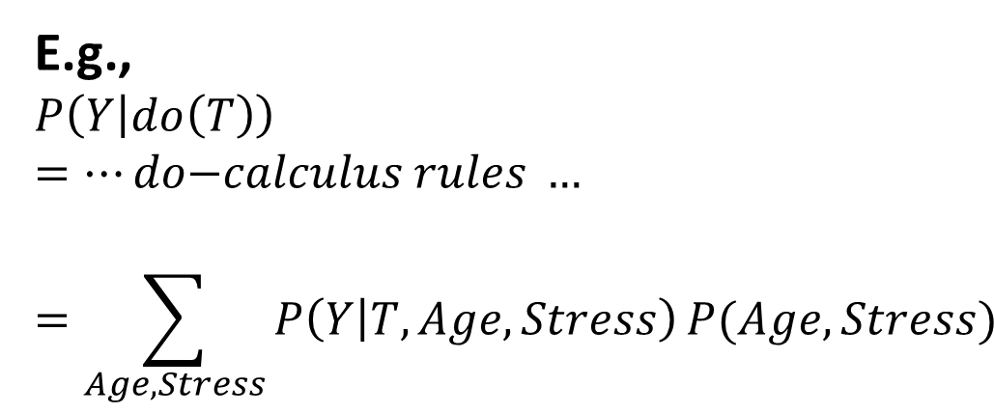
Key Benefit 2 of SCM: Provides a mechanistic way of identifying causal effect
do-calculus: A rule-based calculus that can help identify any counterfactual quantity.
Age
Stress
E.g.,
$$P\left(Y | do\left(T\right)\right)=…do\text{−}calculus rules …$$
$$=\sum_{Age,Stress}{P\left(Y | T,Age,Stress\right)}P(Age,Stress)$$
Occupation
do-calculus is complete: If we cannot identify using do-calculus, causal effect is unidentifiable.
T
Y

Slide 58
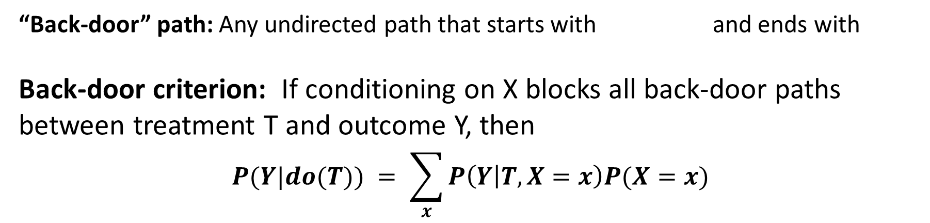
Advanced Topic: Back-door criterion
Three kinds of node-edges
Path is “blocked”
A
A
A
If conditioned on X
If conditioned on X
If not conditioned on X
T
Y
“Back-door” path: Any undirected path that starts with and ends with
Back-door criterion: If conditioning on X blocks all back-door paths between treatment T and outcome Y, then
$$P(Y|do(T)) = \sum_{x}{P\left(Y | T,X=x\right)P(X=x)}$$

Slide 59
Let us return to our examples
Age
Age
Gender
Age
Stress
T
Y
T
Y
T
Y
$$X=\{Age\}$$
$$X=\{Age, Gender\}$$
$$X=\{Age\}$$

Slide 60
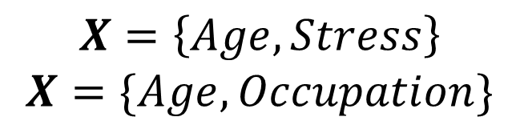
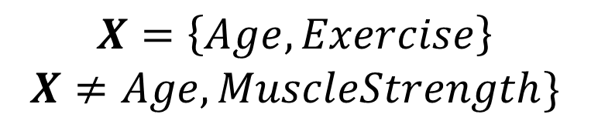
Back-door criterion provides a precise way to find variables to condition to
Age
Stress
Age
Exercise
Occupation
Muscle Strength
T
Y
T
Y
$$X=\left\{Age,Stress\right\}$$
$$X=\{Age, Occupation\}$$
$$X=\left\{Age,Exercise\right\}$$
$$X≠Age, MuscleStrength\}$$

Slide 61
Both frameworks have merits
Use structural causal model and do-calculus for
modeling the problem
making assumptions explicit
identifying the causal effect
Use potential outcomes-based methods for
estimating the causal effect

Slide 62
Recap: Structural Causal Models
Allow us to make causal assumptions explicit
Assumptions are the missing edges!
Provide language for expressing counterfactuals
Well-defined mechanisms for reasoning about causal relationships
E.g., Backdoor criterion

Slide 63
Recap: Section 1 - Introduction
Causality is important for decision-making and study of effects
Potential Outcomes Framework gives practical method for estimating causal effects
Translates causal inference into counterfactual estimation
Unobserved confounds are a critical challenge
Structural Causal Model Framework gives language for expressing and reasoning about causal relationships

Slide 64
PART I. Introduction to Counterfactual Reasoning PART II. Methods for Causal Inference PART III. Large-scale and Network Data PART IV. Broader Landscape

